Slide 1
Penalty Monitor for Violating Traffic Rules using Cloud Computing
TEAM MEMBERS
Dwarakeshwaran B M- 723715104006
Manikandan M - 723715104021
Manoj Prabhu D -723715104025
Raghin R - 723715104039
TEAM GUIDE
Mr. R. Chandrasekar (HOD/CSE)

Slide 2
ABSTRACT
Digitalizing the normal paper receipt.
Providing the acknowledgement to the common people.
Monitoring individual traffic inspectors.
Store the information over the offenders and their cases.

Slide 3
OBJECTIVE
Digitalizing the fine receipt.
Monitoring the cops from a centralized database.
Providing text message to the offender for their offence.
Providing proper evidence of pay in case of caught by multiple cops.

Slide 4
EXISTING SYSTEM
In existing system, only manual writing in a Challan is practiced.
Acknowledgement is not provided.
No accurate database records for traffic violations.

Slide 5
PROPOSED SYSTEM
To avoid fraudulent activities and to regulate the process of fining traffic violators.
Acknowledgement is provided.
Complete database is maintained and also produces accurate results.

Slide 6
DOMAIN
Client-Server Model used for Web & App Development
QR Code Scanning for Mobile App
Cloud Computing for Website

Slide 7
TECHNOLOGIES USED
FRONT END
Android App
XML
Java
Website
Javascript
HTML
CSS
BACK END
Android App
JSON
Website
NodeJS
Firebase
JSP

Slide 8
HARDWARE & SOFTWARE REQUIREMENTS
Android App
Android Studio
Emulator – AVD
Linux OS (MINT)
Firebase
Linux Cinnamon Mint
Website
Windows 7 Ultimate
Eclipse
Sublime Text Editor

Slide 9



ARCHITECTURE DIAGRAM
Web Server
Servelet
FireBase
DBaaS
json
Data
jsp

Slide 10
MODULES
App module has 5 activities.
Splash Screen
Login Activity
Offender information submission activity
Section Number Entering Activity
Offence Information Provider Activity
Website module has 3 activities.
Login Page
Database View Page
Database Modify Page

Slide 11
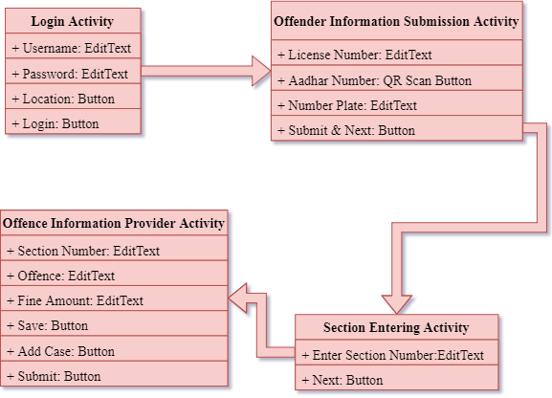
DATA FLOW DIAGRAM

Slide 12
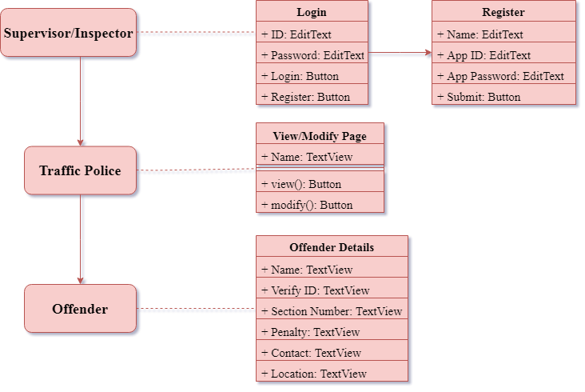
DATA FLOW DIAGRAM

Slide 13
LITERATURE SURVEY
No. | Name | Description | Pros | Cons
1. | Study on Google Firebase for Website Development (The real time database). | Firebase is a “NoSQL” database which are useful for large sets of distributed data. NoSQL databases are effective for big data performance issues that relational databases aren't built to solve. | •Scalable. •Hierarchical Storage. | Internet Connection is needed.
2. | Application of Firebase in Android App Development- A Study. | The server used for Android apps are Oracle SQL, Microsoft SQL Server, and MySQL which are connected to the server with PHP files. Then Firebase came into existence for Android apps which uses JSON for storing data. | Has real-time and cloud-based database where you can store data is JSON and synchronized continuously. | Querying and aggregating are limited compared to SQL.

Slide 14
LITERATURE SURVEY
No. | Name | Description | Pros | Cons
3. | Retrieve Real-time Data in Android Using Firebase. | Firebase is a cloud based platform for mobile and Web application development. Explains how to use Firebase’s cloud services to store and retrieve real-time data. | Realtime / streaming updates are pretty easy. The data structure is JSON which maps perfectly to UI JavaScript. | Firebase is somewhat deprecated in favor of Cloud Firestore.
4. | Making It Work for Everyone: HTML5 and CSS Level 3 for Responsive, Accessible Design on Website. | The bulk of the article explains the design philosophies of progressive enhancement and responsive web design, and summarizes recent updates to WCAG 2.0, HTML5, CSS Level 3, and WAI-ARIA. | Canvas Element Allows storing files or web application makes them accessible without internet connectivity. | Considerable effort even if wishes to carry out a minor change in the site. Not all browsers support HTML5 which is being counted as the major drawback.

Slide 15
LITERATURE SURVEY
No. | Name | Description | Pros | Cons
5. | A Comprehensive analysis of XML and JSON web technologies. | XML and JSON is compared in different aspects and then on the basis of these comparisons conclusion has been derived that which technology is required for whom and for what purpose. | Concise format name/value pair -based approach. | No namespace support, hence poor extensibility
6. | Android Based Mobile Application Development And Its Security. | Android mobile platform for the mobile application development, layered approach and the details of security information for Android is discussed. | Budget-friendly option. | Endangering data privacy.

Slide 16
LITERATURE SURVEY
No. | Name | Description | Pros | Cons
7. | Database in Cloud Computing - Database-as-a Service (DBaas) with its Challenges. | A DBaaS promises to move much of the operational burden of provisioning, configuration, scaling, performance tuning, backup, privacy, and access control from the database users to the service operator, offering lower overall costs to users. | The database is off site, meaning loss of power or natural disaster at your business doesn’t affect it. | Don’t have direct access to the servers that are running your database.
8. | Cloud Database: Database-As-A Service | The structure of database in cloud computing and its working in collaboration with nodes is observed under database as a service. | The DBaaS model can also help reduce data and database redundancy and improve overall Quality of Service. | Database doesn't support features such as data compression and table partitions.

Slide 17
LITERATURE SURVEY
No. | Name | Description | Pros | Cons
9. | QR Code Scanning app for Mobile Devices. | Present an implementation of an Android device using libraries and combined algorithms in order to be able to scan any QR code fast accurate and easy. | Ease of use. Range of uses. QR codes are traceable. | Scanning can be a long process. Lack of awareness.
10. | A Comparative Study between Dynamic Web Scripting Languages. | Compared the impacts of these three languages on the performance of a web server. Have described and analyzed the results of conducting experiments on four benchmarks. | Dynamic content generated for each user Easy to update with a CMS like Wordpress More powerful with features like login, payments, etc. | Expensive-setting up, maintaining, and scaling a database is costly. Complex-much more steps involved to setup and deploy vs a static site.

Slide 18
LITERATURE SURVEY
No. | Name | Description | Pros | Cons
11. | A Comparative Study of Web Development Technologies Using Open Source and Proprietary Software. | Presents a comparison of web application development technologies using open source software and proprietary software. | The source code is not shared with the public for anyone to look at or change. | Many people have access to the source code of open source software, but not all of them have good intentions.
12. | Mobile Application Development: All the Steps and Guidelines for Successful Creation of Mobile App: Case Study. | Numerous factors that can play a significant role in successful app development are discussed with specific examples and explanation. | Compatibility. Support and Maintenance. | Offline Access Convenience

Slide 19


